Slide 1
Build a Web Application
Week 12

Slide 2
A Reflection on REST REpresentational State Transfer
Separation of Client and Server
Applications are no longer monolithic
User Interface, Data and Logic are ‘independent’
Statelessness
Server saves all information at the end of each transaction
Server has defined endpoints to service a request
Client must introduce itself each time to do a transaction
Client makes a request with an HTTP verb

Slide 3
A Reflection on REST REpresentational State Transfer
Client
Receives the HTML, CSS and JS files
Presents the user interface
Styles page based on CSS rules
Page may have JS to respond to user requests which go to the server
Server
Waits for client requests
Client requests contain the endpoint needed to service the request
Database is used to ‘CRUD’ records based on client data
Responds to user with status code or status code plus content

Slide 4
A Reflection on REST REpresentational State Transfer
Request
An HTTP verb – GET, POST, PUT, DELETE
Includes a path or route to define the endpoint desired and the data to complete the request
Response
Status code – 200 OK, 404 page not found, 304 not modified
Content-type – application/json, text/html, text/css, image/png

Slide 5
In the Middle
The message format is the thing
As long as both sides agree on the format the client and server sides can change significantly and the other side wont care
The API Gateway is the arbiter of requests and responses

Slide 6
Build a Basic Web Application
Create a web app
Connect the web app to a serverless back-end
Add interactivity to your web app with an API and a database

Slide 7
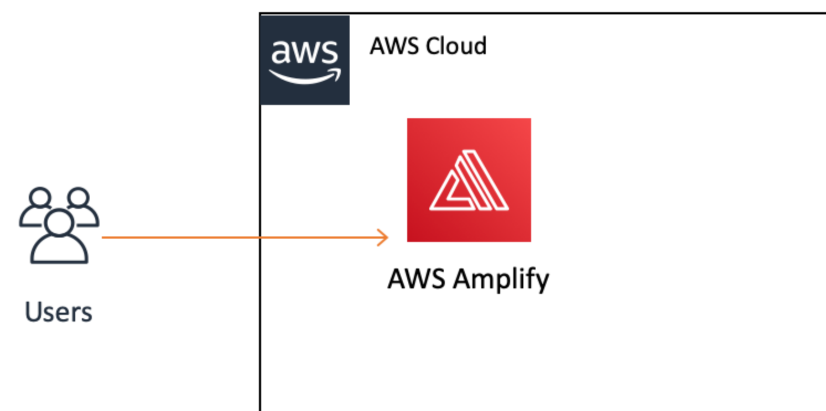
Module 1: Create a Web App What You Will Learn
How to create an Amplify app
How to upload files for a website directly to Amplify
How to deploy new versions of a web page with Amplify

Slide 8
Key Concepts
Static website A static website has fixed content, unlike dynamic websites. Static websites are the most basic type of website and are the easiest to create. All it takes is creating a few HTML pages and publishing them to a web server!
Web Hosting Provides the technologies/services needed for your website to be viewed on the Internet.
AWS Regions Separate geographic areas that AWS uses to house its infrastructure. These are distributed around the world so that customers can choose a region closest to them in order to host their cloud infrastructure there.

Slide 9
Create a Web App with Amplify Console
Need a ‘web site’
Create index.html
Paste in this code
Save and ZIP the file
<!DOCTYPE html>
<html>
<head>
<meta charset="UTF-8">
<title>Hello World</title>
</head>
<body>
Hello World
</body>
</html>

Slide 10
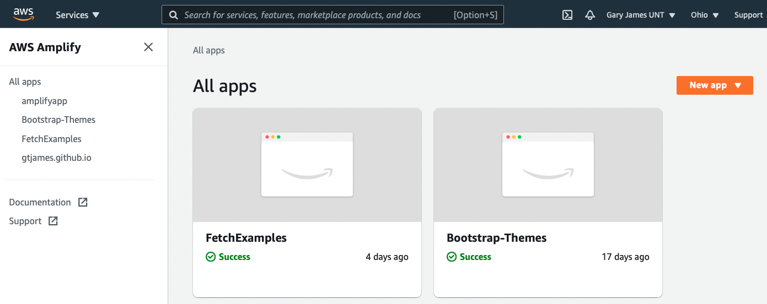
Amplify Console
Click on New app

Slide 11
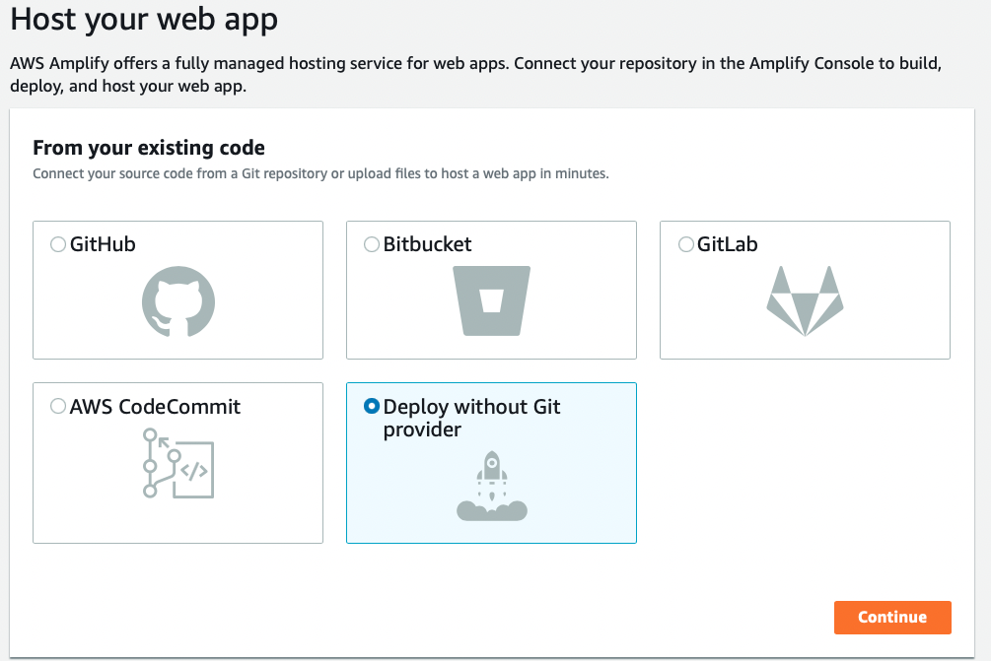
Host your web app
Deploy without Git provider
Click Continue

Slide 12
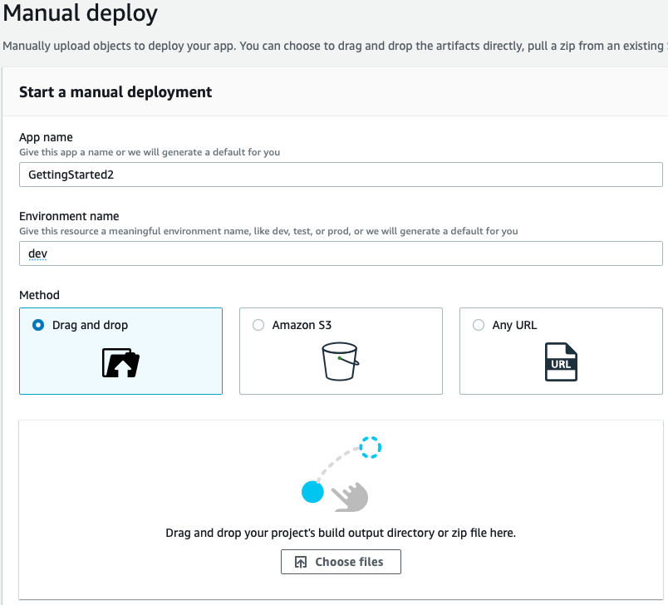
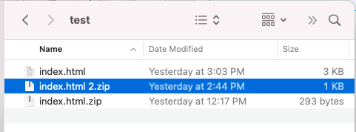
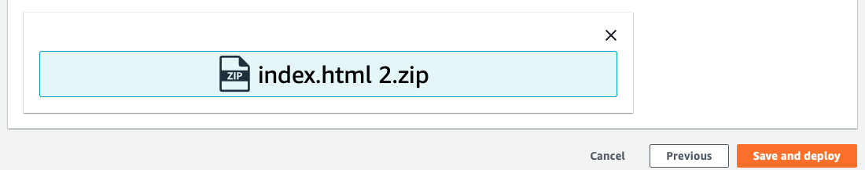
Manual deploy
App Name: GettingStarted
Environment: dev
Drag and drop: your compressed file
Save and deploy

Slide 13
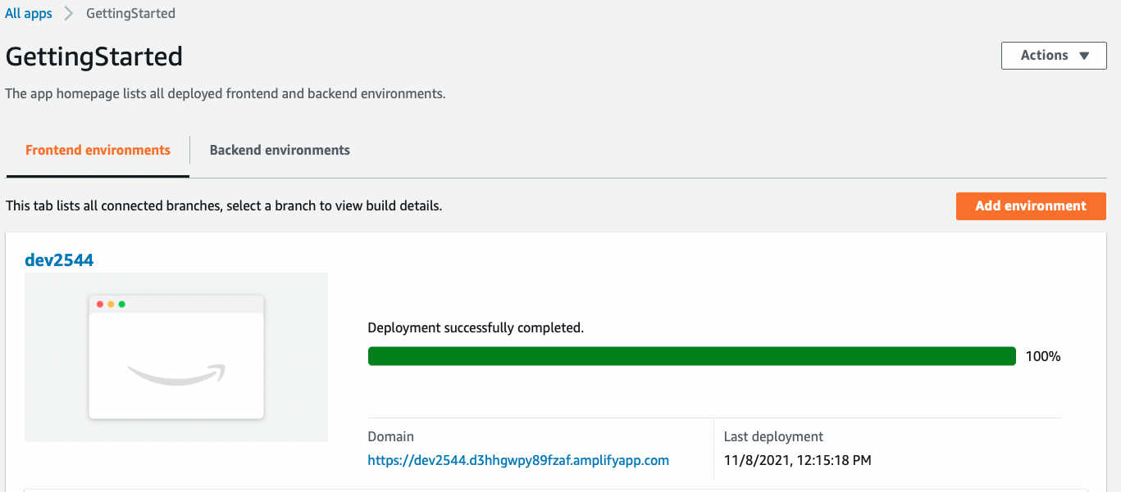

Slide 14
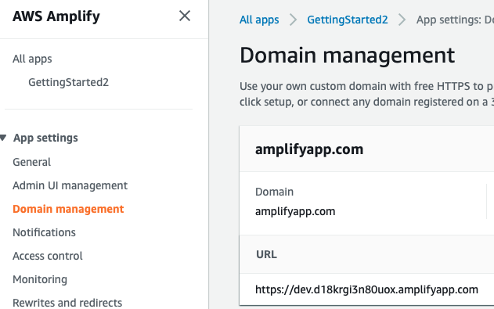
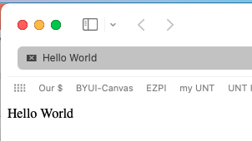
Test Your Web App
Click on Domain Management
Copy URL and paste into your browser

Slide 15
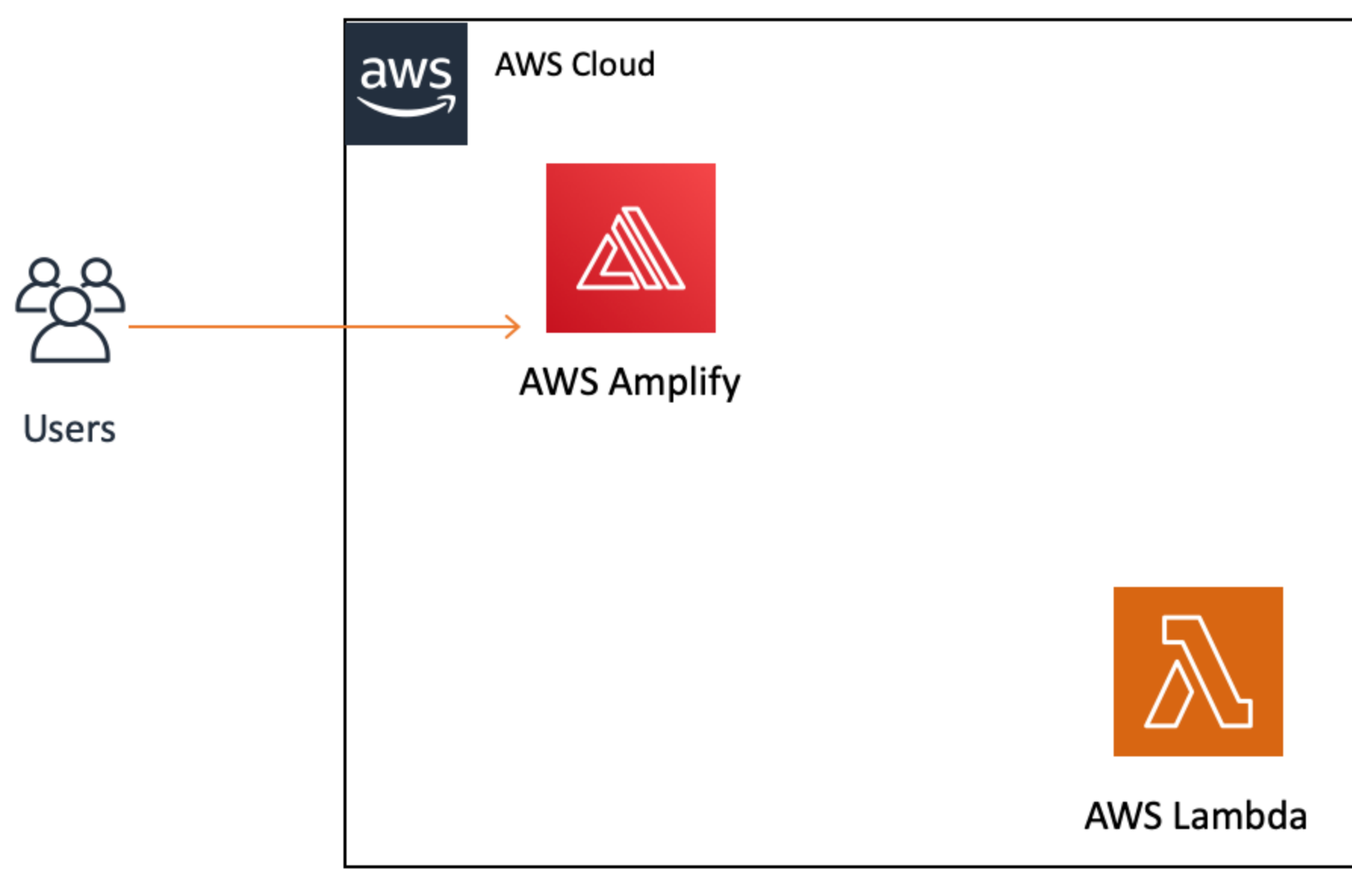
Module 2: Build a Serverless Function What You Will Learn
Create a Lambda function from scratch using the AWS console (in Python, JavaScript, or Java)
Create (JSON) events in the AWS console to test your function

Slide 16
Key Concepts
Compute Service Service that provides computational processing power.
Serverless function Piece of code that will be executed by a compute service, on-demand.
Lambda Trigger The type of event that will make a Lambda (serverless) function run. This can be another AWS service or an external input.

Slide 17
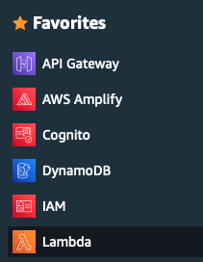
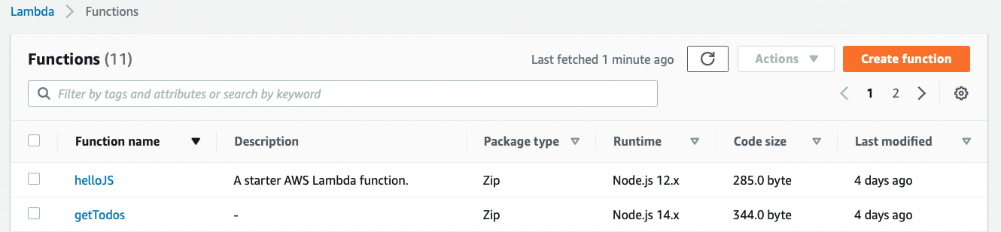
Go to the Lambda tab

Slide 18
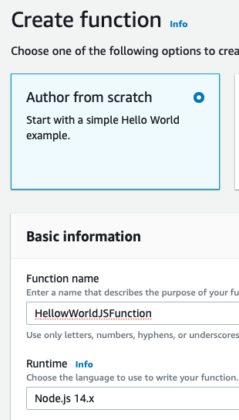
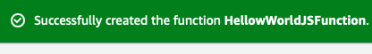

Create a Lambda Function
Function Name: HelloWorldFunction
Runtime: Node.js 14.x
Create Function

Slide 19
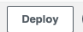
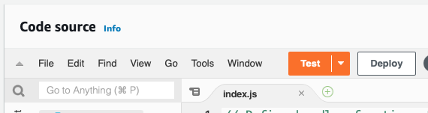
Modify the JavaScript Code Source
// handler function, the entry point to our code
// Receives event param that triggers the function exports.handler = async (event) => {
// Extract values from event and format as string
let name = JSON.stringify(`Hello from Lambda,
${event.firstName} ${event.lastName}`);
// Create a JSON object with our response
// and store it in a constant
const response = {
statusCode: 200,
body: name
};
// Return the response constant
return response;
};
Replace old code with this new function
Save
Deploy

Slide 20
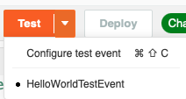
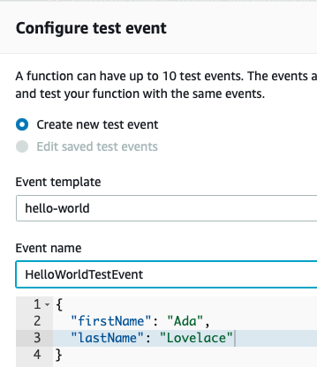
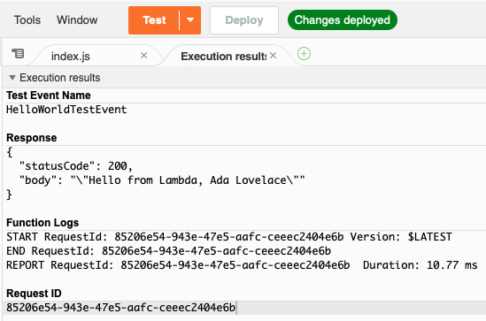
Configure test event
Configure test event
Create the JSON to be passed as the event parameter
Event name: HelloWorldTestEvent
Save
Test
Note Response

Slide 21
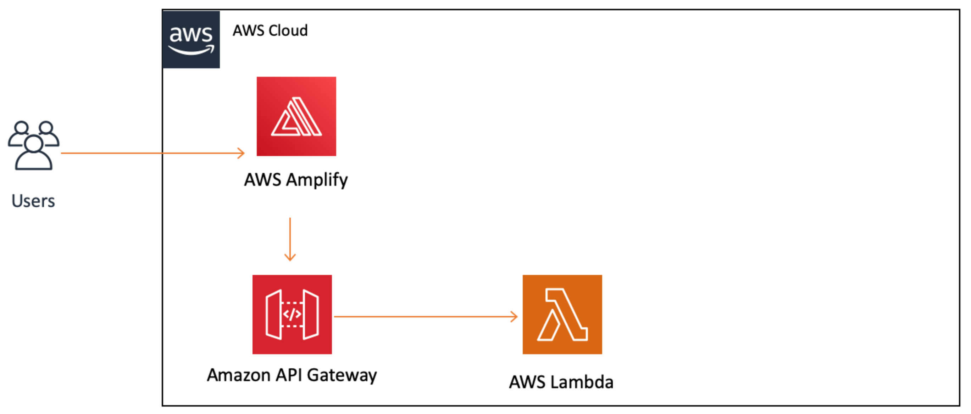
Module 3: Link a Serverless Function to a Web App What You Will Learn

Slide 22
Module 3: Link a Serverless Function to a Web App What You Will Learn
Create a new API using API Gateway
Define HTTP (Hypertext Transfer Protocol) methods on your API
Trigger a Lambda function from an API
Enable CORS on an API so you can consume it from a website
Test an API created with API Gateway from the AWS Management Console

Slide 23
Key Concepts
RESTful API REST stands for "Representational State Transfer" and it is an architectural pattern for creating web services. API stands for "application program interface." Thus, a RESTful API is one that implements that architectural pattern.
HTTP Request Methods HTTP methods are designed to enable communications between clients and servers. Methods, like GET or PUT defined by the HTTP protocol, are used to indicate what action to take on a resource.
CORS The CORS (Cross Origin Resource Sharing) mechanism uses HTTP headers to tell a browser to allow a given web application run at one origin (domain) and have permission to access selected resources from a server at a different origin.
Edge Optimized A resource that uses the AWS Global Infrastructure to better serve clients all over the world.

Slide 24
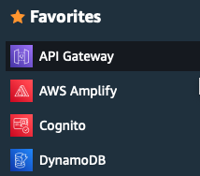
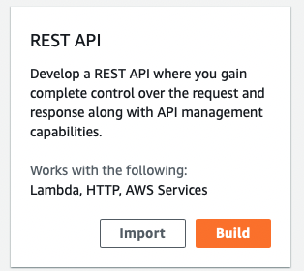
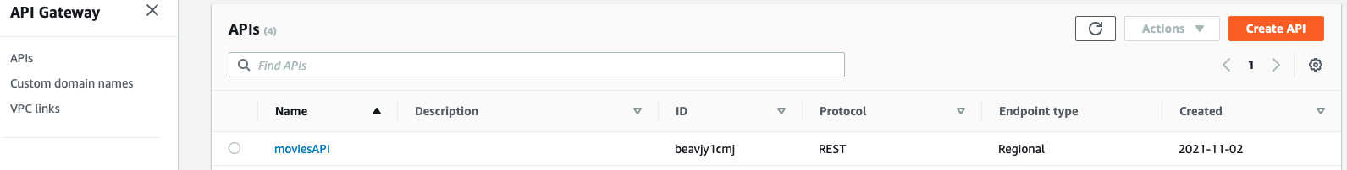
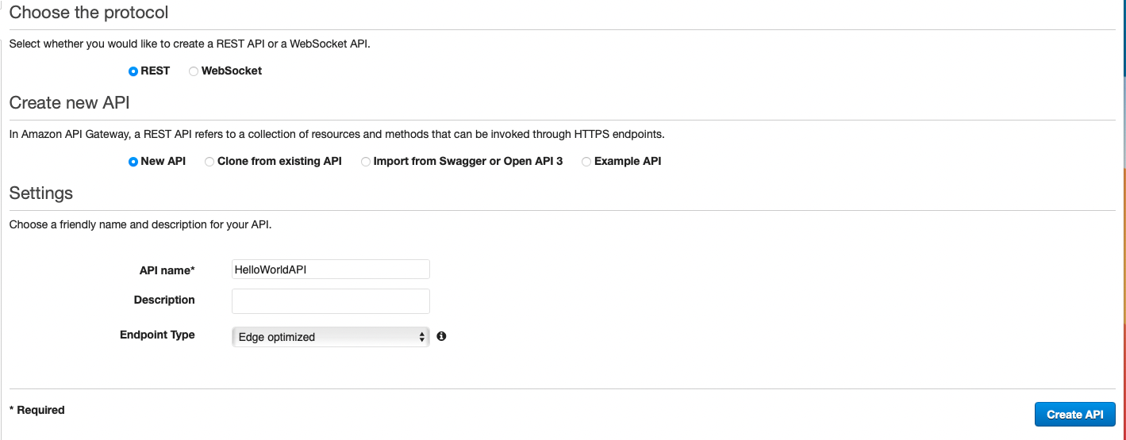
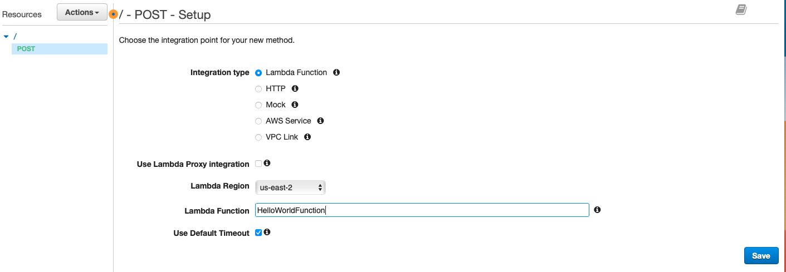
Create a New REST API
Endpoint Type : Edge optimized
Best for geographically distributed clients.
Good choice for public services being accessed from the Internet.
Regional endpoints are typically used for APIs that are accessed primarily from within the same AWS Region.
Save

Slide 25
Create Method POST
Lambda Function: HelloWorldFunction
Save

Slide 26
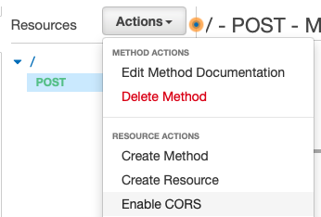
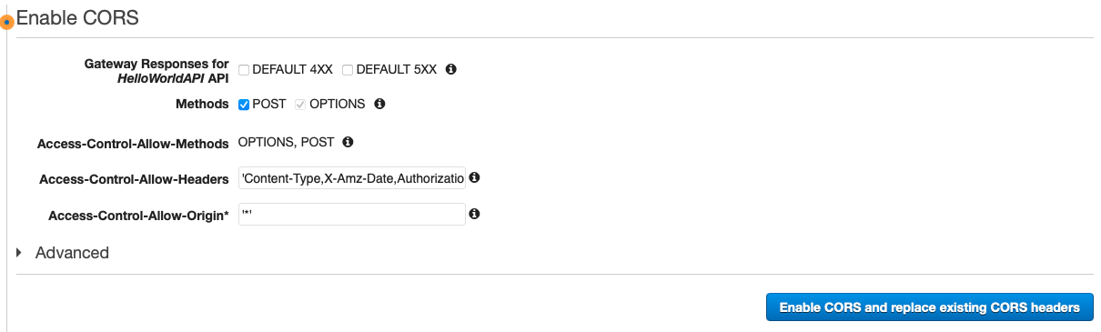
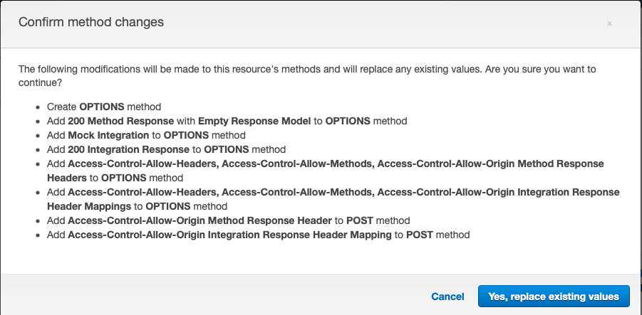
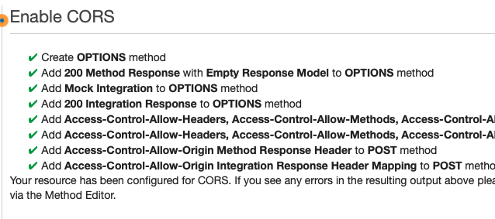
Enable CORS
Actions – Enable CORS
Enable CORS and replace existing CORS headers
Yes, Replace existing values

Slide 27
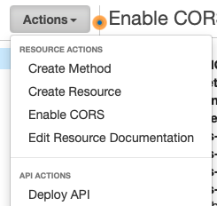
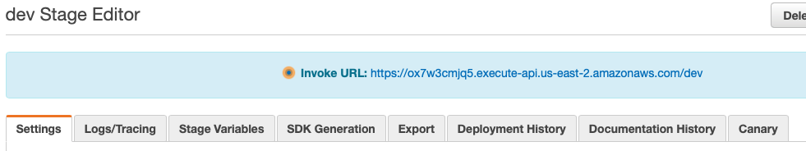
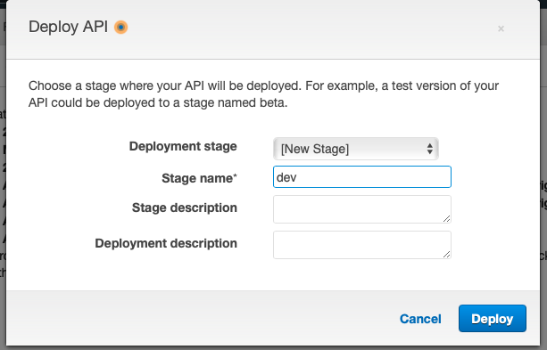
The URL below is your route
https://ox7w3cmjq5.execute-api.us-east-2.amazonaws.com/dev

Slide 28
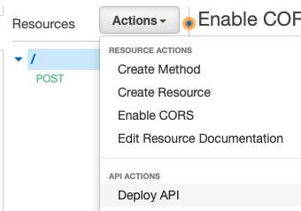
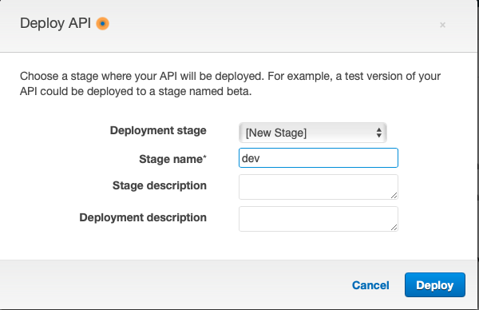
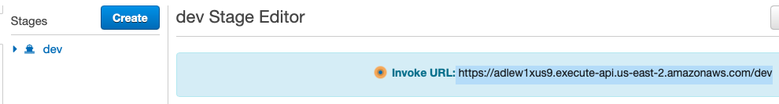
Deploy API
Deploy API
Create new stage: dev
Deploy
https://adlew1xus9.execute-api.us-east-2.amazonaws.com/dev

Slide 29
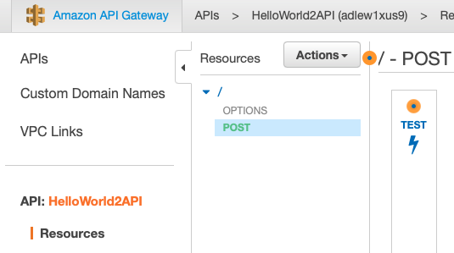
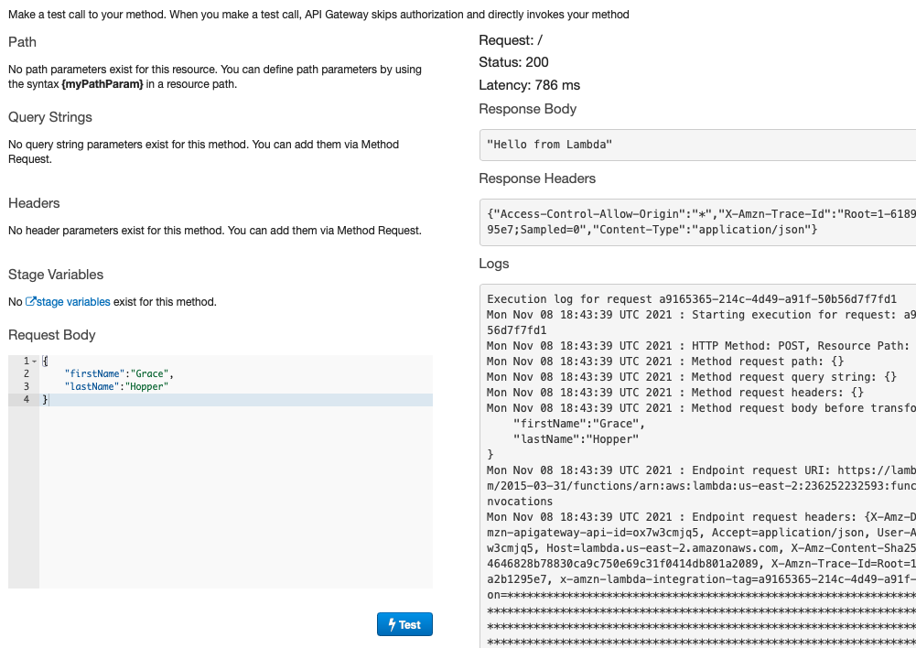
Deploy API

Slide 30
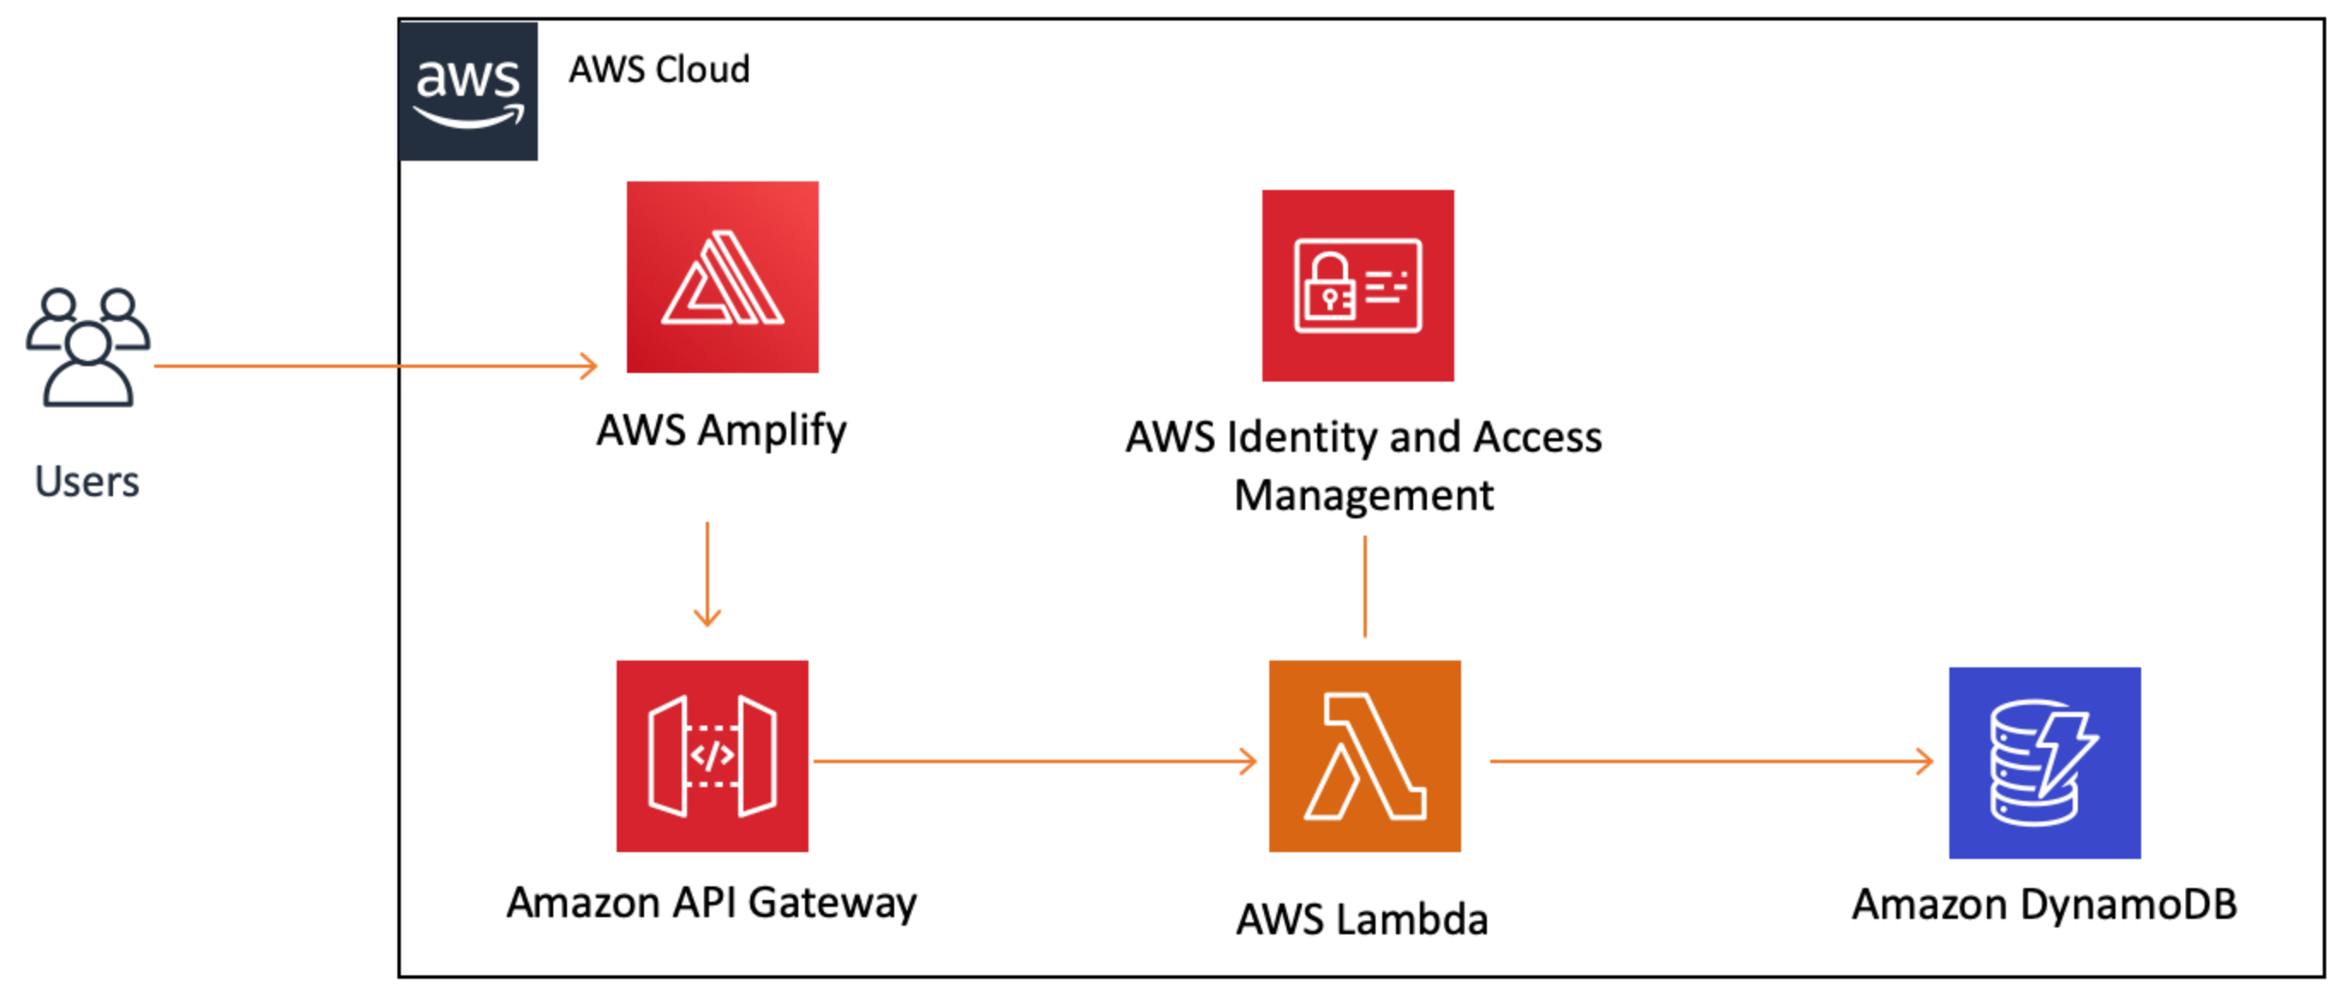
Module 4: Create a Data Table

Slide 31
Module 4: Create a Data Table What You Will Learn
Create a DynamoDB table using the AWS Management Console
Create a role and manage permissions with IAM
Write to a DynamoDB table using the AWS SDK (Python, JavaScript, or Java)

Slide 32
Key Concepts
Persisting Data Storing data to access in the future independently from program execution.
Non-Relational Database A non-relational database does not use a tabular schema of rows and columns. Storage is optimized for the specific requirements of the data being stored.
Key-Value Database JSON-like data, a collection of key-value pairs.
Primary Key The value that will identify each piece of data in a DynamoDB table. This value will also serve to partition the table to make it scalable.
Schema The organization of data, a blueprint for how a database should be constructed.
AWS SDK Provide a set of tools, libraries, documentation, code samples, processes, and guides that allow developers to create software applications on a specific platform.
IAM Policy Defines what AWS resources an entity (e.g., service, user, group) has access to.

Slide 33
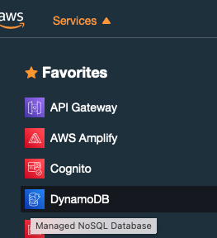
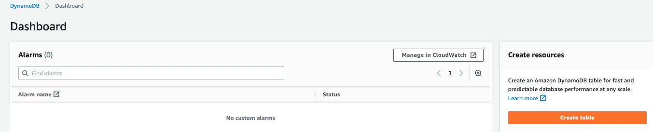
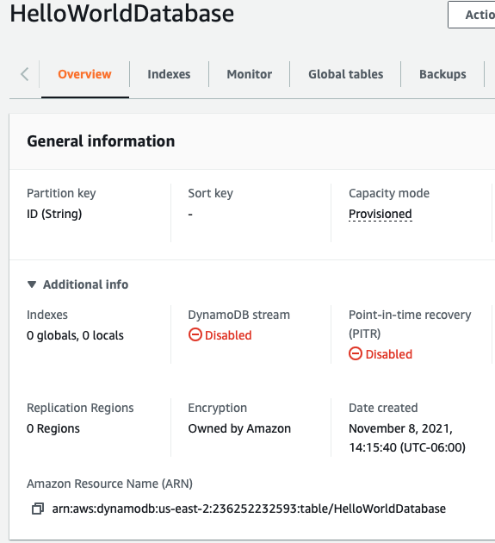
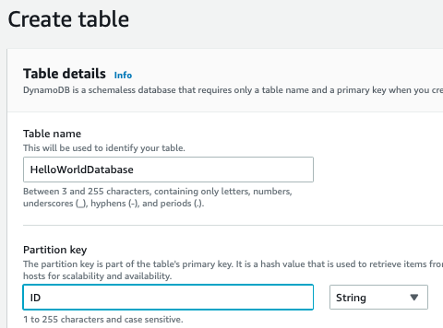
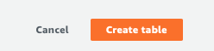
Create a DynamoDB Table
DynamoDB
Create Table
Open Additional Info
Save the Amazon Resource Name (ARN)
arn:aws:dynamodb:us-east-2:236252232593:table/HelloWorldDatabase

Slide 34
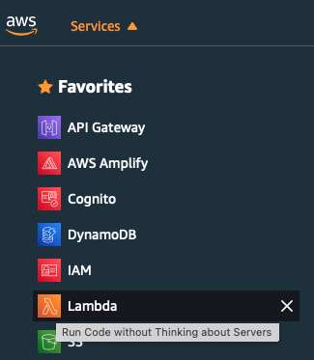
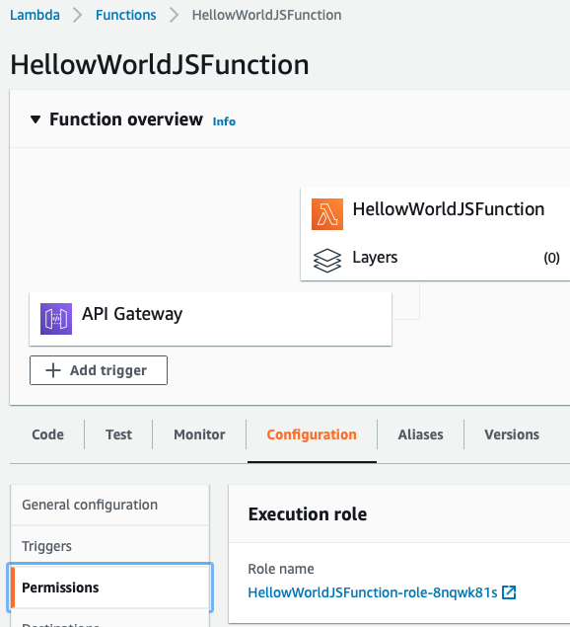
Create and Add IAM Policy to Lambda Function
Lambda Console
Select Function
Configuration panel
Permissions tab
Execution role – click on role

Slide 35
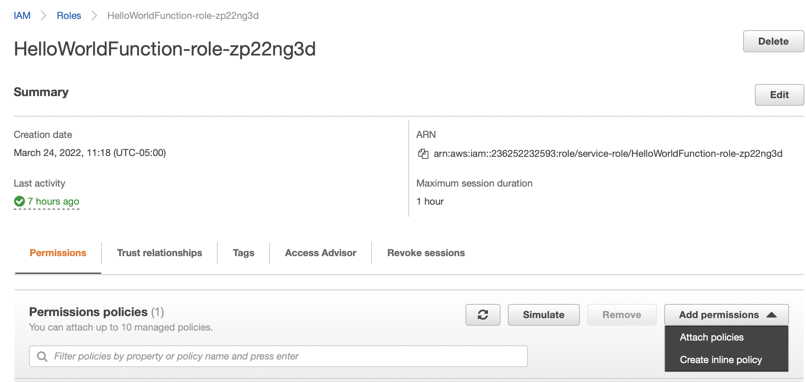
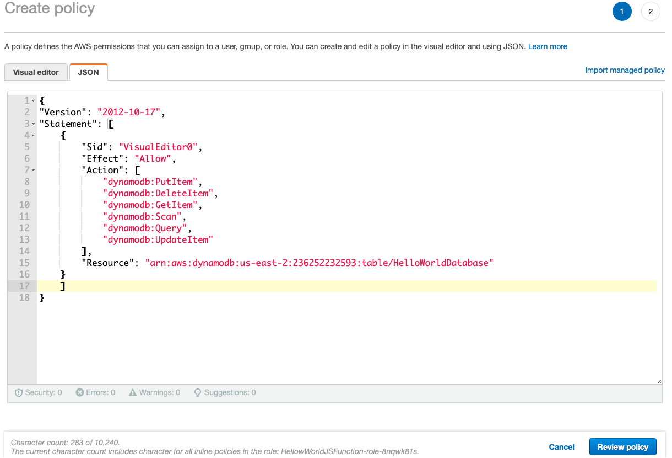
Add inline policy
Click on “Add inline policy”
Paste in new policy
Review Policy

Slide 36
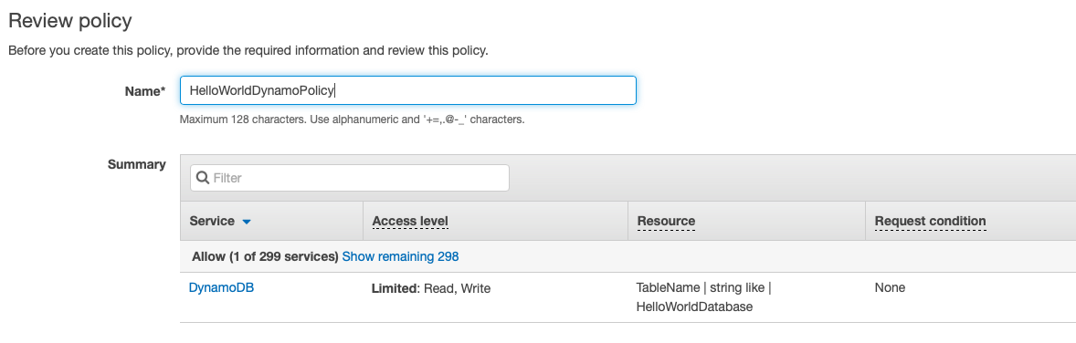
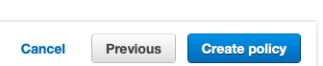

Slide 37
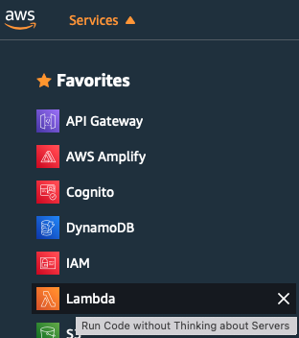

Modify Lambda function to Write to DynamoDB table
Click the ”Code" tab
In the tutorial remember to use the JS code
Paste in the updated code
Deploy the code

Slide 38


Test the Changes
Make sure code is deployed
Press Test
Go to DynamoDB Tables
See the new record
Modify the Test JSON and repeat

Slide 39
Module 5: Add Interactivity to Your Web App What You Will Learn
Call an API Gateway API from an HTML page
Upload a new version of a web app to Amplify Console

Slide 40
Key Concepts
Deploying a website Making a website available to users.
Environment A stage such as "prod," "dev," or "staging" where an application or website can be executed.
Invoking an API Sending an event to an API to trigger a specific behavior.

Slide 41

Update Web App with Amplify Console
Return to your index.html file
Replace the existing code
Make sure you add your API Invoke URL on Line 41
You can find in in API Gateway Console – Stages
Click on dev
Save the file
Compress it

Slide 42





Upload new index.html
Find your Web Site
GettingStarted
Click on Choose files
Find and upload

Slide 43


Test Updated Web App
Click on URL under Domain
MAKE SURE to refresh your browser

Slide 44


